Slide 1

Leader Election Project Overview
Introduction to the Leader Election Project: An overview of the project focusing on creating a consensus algorithm using VRF for a fair and verifiable leader election process among a network of nodes.

Slide 2

Project Structure
Gradle Build Scripts: Used for setting up and managing the project dependencies and configuration.
Source Code: Contains the implementation of the consensus algorithm and leader election.
Dependencies and Configuration: The project uses Kotlin and several cryptographic libraries for VRF and secure random number generation.

Slide 3

Main Execution Flow
Initialization: Create a VRF instance and secure random number generator.Generate a global randomness value.Initialize any number of nodes each with a unique key pair and contribution value.
Leader Election: Use the VRF to generate a hash for each node based on the global randomness and the node's private key.Elect the node with the minimum hash value that passes the selection criteria as the leader.

Slide 4

Global Configuration
Global Randomness: A random value used for generating hashes (Generated by the node starting the election and shared to the nodes who are taking part).
Nodes List: A list containing all the nodes participating in the consensus algorithm.

Slide 5
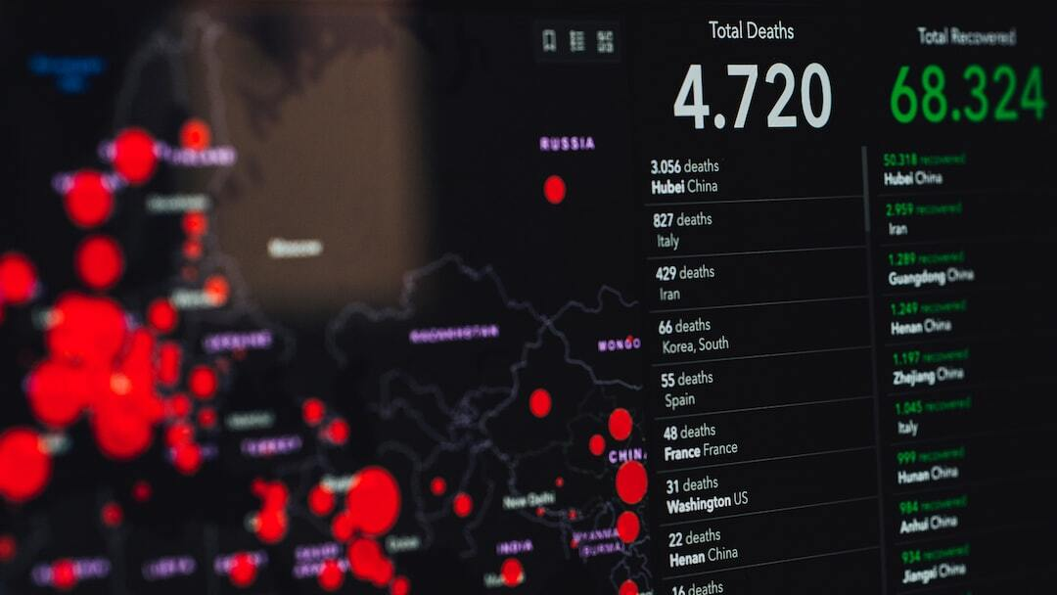
Leader Election Algorithm
Total Contribution Calculation: Calculate the sum of contributions from all nodes.
Hash Generation: Each node generates a hash based on the global randomness and its private key.
Candidate Verification: Nodes verify each other's hashes to ensure they meet the selection criteria.
Leader Selection: The node with the smallest valid hash is elected as the leader.

Slide 6

Node Representation and Hash Generation
Node Attributes: Each node has an ID, address, public key, private key, and contribution value.
Hash Generation: Nodes use their private key and the global randomness to generate a hash.
Hash Verification: Nodes verify each other's hashes to ensure they are valid and meet the selection criteria.

Slide 7

Verifiable Random Function (VRF)
Key Pair Generation: Each node generates a public-private key pair.
Hash Generation: Using the private key, nodes generate a hash from the global randomness. If they don’t pass the 2nd round, they will return a NULL value; else, they will return their hash.
Hash Verification: Using the public key, randomness, and hash, nodes verify the hashes generated by other nodes and check if the node has passed the 2nd round.

Slide 8

Using SHA-256 with ECDSA
Introduction: SHA-256 is a cryptographic hash function that produces a 256-bit hash value. ECDSA (Elliptic Curve Digital Signature Algorithm) is a public key encryption technique based on elliptic curve cryptography.
How It Works: 1. Hashing: The message is hashed using SHA-256. 2. Signing: The hash is then signed using ECDSA with the sender's private key. 3. Verification: The signature is verified using the sender's public key.
Benefits: - SHA-256 and ECDSA provide robust security against cryptographic attacks. - Shorter key lengths for equivalent security levels compared to other algorithms. - Data integrity and authenticity, preventing tampering and forgery.

Slide 9

Mathematical Details
Exponential Function for Selection Probability: The probability function f(q, Q) = 1 - e^(-q⋅u), where u = ln(1/(1-t)) and t = 1/Q, determines the likelihood of a node being selected as a candidate based on its contribution. Here, q is the current node contribution, and Q is the total contribution (sum of all q).
Hash Value and Selection: The generated hash, after reversing, is converted into a numerical value. This value is compared with a threshold based on the node's contribution. Only nodes with hash values meeting the threshold are considered for leader election. This is the 2nd round.

Slide 10

Why VRF
Traditional Leader Election Vulnerabilities: In normal leader election, the nodes are exposed before they generate the block, making them susceptible to DoS attacks or other types of attacks.
Advantages of VRF: VRF ensures that nodes are not exposed by making the pseudorandom function random, providing enhanced security and fairness in the leader election process.

Slide 11

Application on Mobile Application
Mobile Integration: Servers can be set up to save nodes and their contributions. When a node wants to mine a block, it initiates the election process by calling other nodes.
Process Flow: Nodes return their hash if they are selected. The initiating node passes these hashes to other nodes for verification. The node with the minimum hash among the final few candidates is selected as the leader.

Slide 12

Problem Encountered
Problem: Using SHA-256 with ECDSA for hash generation resulted in hashes that were very close to each other and not uniformly distributed.
Solution Implemented: Reversed the hash and converted it to a range of 0-1 by dividing by 2^n, where n is the number of bits in the hash.
Application: This method enhances the uniformity of hash distribution, critical for applications where the number of leaders should be less.

Slide 13

Conclusion
Summary of Process: The project demonstrates a secure and fair leader election process using a VRF, ensuring that the elected leader is verifiably chosen based on node contributions.
Advantages: This approach combines cryptographic techniques and probabilistic methods to achieve consensus in a decentralized network.

